Slide 1
Fundamentals of Android Applications
Unit-1

Slide 2
Topics
OOPS
Software Engineering
Basics of Android and Android application

Slide 3
Why we use java
Java is a popular and widely-used programming language for many reasons. Here are some key reasons why developers choose Java:
1. Platform Independence
Write Once, Run Anywhere (WORA): Java code is compiled into bytecode, which can be run on any device equipped with the Java Virtual Machine (JVM). This platform independence is one of Java's most significant advantages.
2. Object-Oriented Programming
Modularity and Reusability: Java's object-oriented nature encourages the use of modular code, which can be reused across different programs. This leads to better organized and more manageable code.

Slide 4
3. Rich Standard Library
Extensive APIs(Application Programming Interface) : Java has a vast standard library that provides many useful APIs for tasks like I/O operations, networking, data structures, and much more, reducing the need to write code from scratch.
Work of API-An API is a set of rules and protocols that allows different software applications to communicate with each other. It defines the methods and data structures that developers can use to interact with the functions and features provided by a particular software component or service.
4. Strong Memory Management
Automatic Garbage Collection: Java handles memory allocation and deallocation automatically through its garbage collection mechanism, reducing the likelihood of memory leaks and other related issues.

Slide 5
5. Robust and Secure
Strong Exception Handling: Java provides a robust framework for exception handling, making it easier to write error-free code. Security Features: Java offers comprehensive security features, including bytecode verification, sandboxing, and built-in security APIs.
6. Multi-threading Capability
Concurrency Support: Java has built-in support for multi-threading, allowing developers to write programs that can perform multiple tasks simultaneously, leading to more efficient and responsive applications.

Slide 6
. Community and Ecosystem
Large Developer Community: Java has a vast and active developer community, offering extensive documentation, tutorials, and third-party libraries and frameworks. Enterprise Adoption: Java is widely used in enterprise environments, making it a valuable skill for developers in the job market.
8. Development Tools
Integrated Development Environments (IDEs): There are several powerful IDEs available for Java development, such as Eclipse, IntelliJ IDEA, and NetBeans, which provide tools for code completion, debugging, and project management.

Slide 7
Environments
Integrated Development Environments (IDEs):
Eclipse: A popular, open-source IDE for Java development.
IntelliJ IDEA: A feature-rich, commercial IDE with a free community edition.
NetBeans: An open-source IDE supported by the Apache Software Foundation.
Visual Studio Code: A lightweight, open-source editor that supports Java through extensions.

Slide 8
OOP
Object-Oriented Programming (OOP) is a programming paradigm centered around the concept of "objects," which are instances of classes. OOP is designed to help organize and structure software in a more modular and reusable way. The four fundamental principles of OOP are encapsulation, inheritance, polymorphism, and abstraction. Here’s a detailed explanation of each concept:

Slide 9
Class
Class in Java
Definition: A class in Java is a blueprint or template for creating objects. It defines a set of properties (fields) and methods (functions) that the objects created from the class will have. A class encapsulates data for the object and methods to manipulate that data.
Components of a Class:
Fields (Variables): Represent the state or attributes of the class.
Methods: Define the behavior or functions that the objects of the class can perform.
Constructors: Special methods used to initialize objects.

Slide 10
Functions
A code which gets executed to perform any task is called Function.
Example.
87
+ 87

Slide 11
Function and Class
CARPENTER
Function
A code which gets executed to perform any task
Class
Group
HOUSEHOLD REPAIR

Slide 12
Object
HOUSEHOLD WEBSITE
Form creation :Kind of Work
Repair Name
Payment
Object

Slide 13
Objects
An object is an instance of a class. When a class is defined, no memory is allocated until an object of that class is created. Objects are the real-world entities that hold specific data and have specific behavior defined by the class.
Creating an Object:
Use the new keyword followed by the class constructor.
The constructor initializes the new object.

Slide 14
Example
Package com.website
public class Main
{
public static void main(String[]args)
{
//Write your code here
System.out println(“Hello World”);
}
}

Slide 15
Let us understand .
Com.company ; ----A package in Java is used to group which can be related to class.
Public --- This means this method can be accessed from anywhere.
Main --- It is the class.
Static --- This helps the program without any object.
Void ---- In this program the function does not provide any return so it is empty that’s why we used void here.

Slide 16
Continue…
main --- Functions
System.out –Output
Println ---This is the general action performed by the method. It takes data and writes it to the console (or another output stream). ln: This most likely stands for "line" because the println method does two things:
Prints the provided data to the console.
Moves the cursor to the next line after printing.

Slide 17


Naming Conventions
PascalCaseConvention
camelCaseConvention

Slide 18
Pascal---Class
For class we use Pascal Convention.
Example
HelloWorld----Both starting letters will be in capital.
Main---First letter in capital.

Slide 19
camelCaseConvention--Function
In camel case convention we use first word’s first letter small and all other words first letter in capital to define a function
Example
helloWorld—Firstword first letter small.
main

Slide 20
Encapsulation
Encapsulation is a mechanism through which we can wrap the data members and members methods of class in a single unit called encapsulation.
Note
Declare the class variables as private.
Declare the class methods as public.

Slide 21
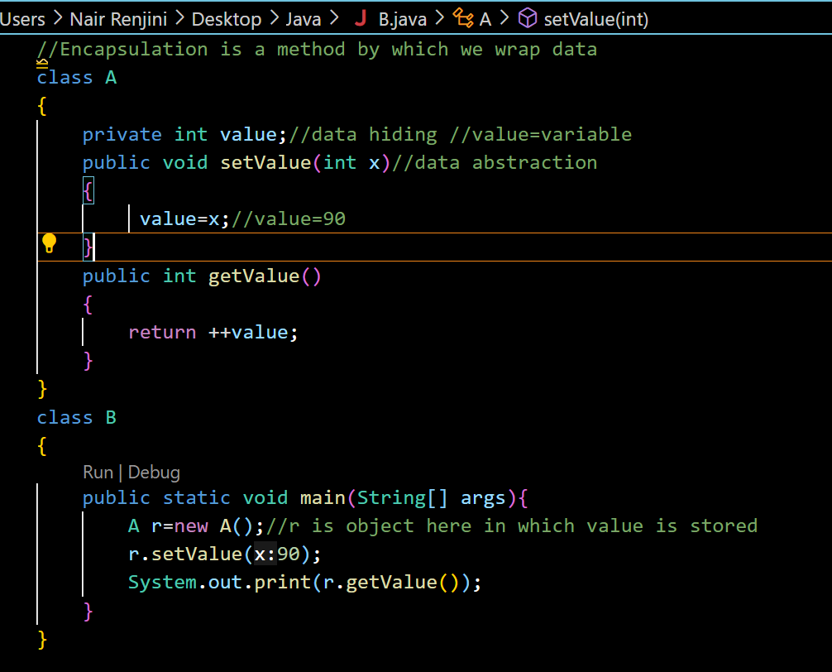

Slide 22
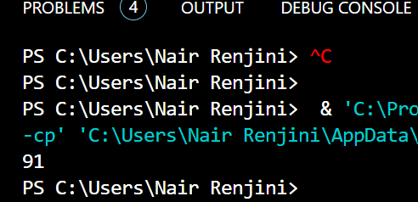
Output

Slide 23
Inheritance
Inheritance is a fundamental concept in object-oriented programming (OOP) that allows a new class to inherit properties and behaviors (fields and methods) from an existing class. This promotes code reuse and establishes a natural hierarchical relationship between classes.

Slide 24
Key Concepts of Inheritance
Superclass (Parent Class)
The class whose properties and methods are inherited by another class.
Also known as the base class or parent class.
Subclass (Child Class)
The class that inherits properties and methods from another class.
Also known as the derived class or child class.
extends Keyword
Used to declare a subclass. The extends keyword is followed by the name of the superclass.

Slide 25
Types of Inheritance
Single / Simple Inheritance
Multi- Level Inheritance
Hierarchical Inheritance

Slide 26
Syntax
Class A
{
}
Class B extends A
{
}

Slide 27
Single / Simple Inheritance
Super Class
Sub Class

Slide 28
Multi-Level Inheritance
Super Class
Sub Class
Sub Class

Slide 29
Hierarchical Inheritance
Super Class
Sub class
Sub class
Sub class

Slide 30
Multiple Inheritance
Parent Class
Parent Class
Child class
Java doesn’t support this

Slide 31
Software Engineering
Software engineering is a systematic, disciplined, and quantifiable approach to the development, operation, and maintenance of software. It involves the application of engineering principles to software development to ensure that software is reliable, efficient, maintainable, and scalable.

Slide 32
Key Concepts in Software Engineering
Software Development Life Cycle (SDLC):
Requirement Analysis: Understanding and documenting what is required by the user and stakeholders.
System Design: Creating the architecture and design of the software system.
Implementation (Coding): Writing the actual code according to the design specifications.
Testing: Verifying and validating that the software meets the requirements and is free of defects.
Deployment: Releasing the software to the user environment.
Maintenance: Updating and improving the software over time.

Slide 33
SDLC-Software Development Life Cycle
This describes the sequence of phases or steps to develop any software.
SDLC contains three main stages:
Conception stage
Implementation stage - Coding
Maintance – Upgrade

Slide 34
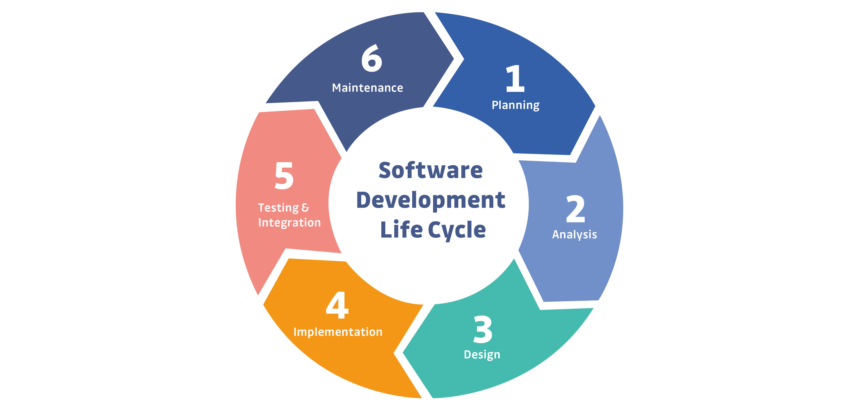
SDLC

Slide 35
SDLC Model
The SDLC Model is classified into three categories based on there advantages and disadvantages.
Waterfall Model (Classical Model)
Prototype Model
Spiral Model

Slide 36
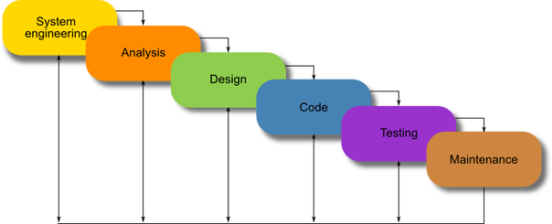
Waterfall Model

Slide 37
Why we call this model as Water Fall
The Waterfall model is one of the earliest methodologies used in software development and systems engineering. It is a linear and sequential approach where each phase of the development process flows into the next, much like a waterfall.

Slide 38
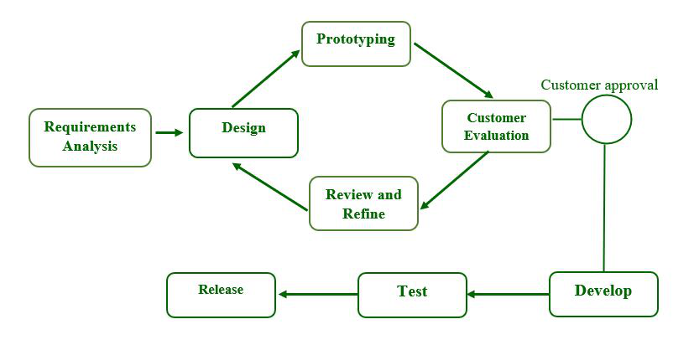
Prototype Model

Slide 39
Prototype Model
The Prototype Model is a systems development methodology in software engineering where a prototype (an early approximation of a final system or product) is built, tested, and then reworked until an acceptable prototype is achieved. This model is particularly useful for projects where the requirements are not well understood from the beginning.

Slide 40
Here are the steps involved in the Prototype Model:
Requirements Gathering and Analysis
Objective: Understand the basic requirements of the system.
Activities:
Gather initial requirements through discussions with stakeholders.
Identify the primary functionalities that the system should have.
Determine what aspects of the system are uncertain or likely to change.
2. Quick Design
Objective: Create a basic design of the system focusing on the aspects that are not well understood.
Activities:
Develop a simplified and preliminary version of the system architecture.
Focus on user interfaces, input, and output processes.
Create mock-ups or sketches of the system.

Slide 41
Con…
Building the Prototype
Objective: Develop an initial version of the system (the prototype) based on the quick design.
Activities:
Implement the basic functionalities of the system.
Ensure the prototype includes enough features to demonstrate the core concepts.
Use tools and techniques that allow rapid development and iteration.
4. User Evaluation
Objective: Gather feedback from users on the prototype.
Activities:
Present the prototype to stakeholders and end-users.
Collect feedback on the prototype’s functionality, design, and usability.
Identify any gaps or misunderstandings in the initial requirements.

Slide 42
Con..
Refining the Prototype
Objective: Improve the prototype based on user feedback.
Activities:
Analyze the feedback and determine necessary changes.
Modify the prototype to incorporate feedback and new requirements.
Iterate this process until the prototype meets user expectations and requirements.
6. Engineer the Product
Objective: Transition from the prototype to the final product.
Activities:
Finalize the system requirements based on the refined prototype.
Design the complete system architecture.
Develop the final system using standard software development practices.
Perform thorough testing to ensure the system meets all requirements and quality standards.

Slide 43
Cont….
System Testing and Implementation
Objective: Ensure the system is fully functional and ready for deployment.
Activities:
Conduct detailed system testing including unit testing, integration testing, and system testing.
Validate the system against user requirements.
Implement the system in the production environment.
Provide training and support to users.
8. Maintenance and Updates
Objective: Maintain the system and implement updates as necessary.
Activities:
Monitor the system for any issues or bugs.
Perform regular maintenance and updates based on user feedback and changing requirements.
Ensure the system remains functional and relevant over time.

Slide 44
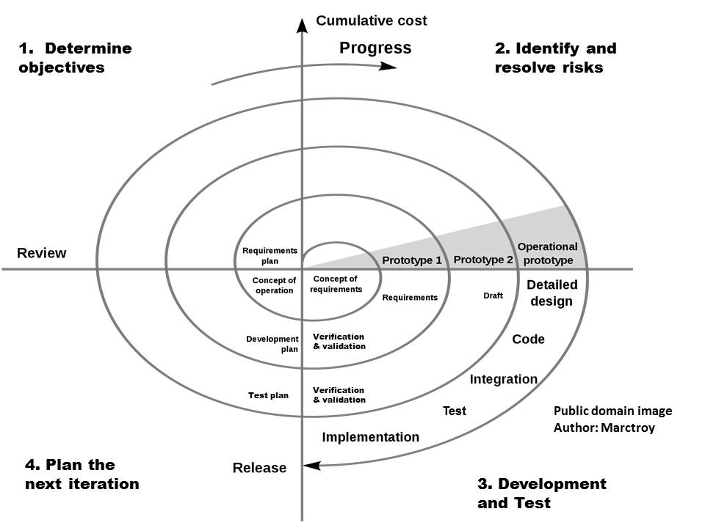
Spiral Model

Slide 45
Con….
The Spiral Model is a risk-driven software development process model that combines elements of both design and prototyping-in-stages. It is intended to be used for large, complex, and high-risk projects. The model was first introduced by Barry Boehm in 1986 and emphasizes iterative development, allowing for continuous refinement and validation of the software throughout its lifecycle.

Slide 46
Key Phases of the Spiral Model
The Spiral Model consists of several iterations or "spirals," each representing a phase of the software development process. Each spiral has four main phases:
Planning:
This phase involves gathering requirements and understanding the objectives of the project. It includes identifying stakeholders, defining requirements, setting constraints, and assessing risks.
Risk Analysis:
In this phase, potential risks are identified, analyzed, and prioritized. This is a critical aspect of the Spiral Model, as it focuses on mitigating risks early in the development process. The outcome of this phase often includes a detailed risk management plan.
Engineering:
This phase involves the actual development of the software, including design, coding, testing, and validation. The engineering phase may include building prototypes to better understand the requirements and test solutions.
Evaluation:
After each iteration, the product and process are evaluated. This includes assessing the deliverables, ensuring that they meet the requirements, and evaluating the overall progress and direction of the project. Stakeholders provide feedback, which is used to improve subsequent iterations.

